Slide 1

Analysis of Education and Socioeconomic Status
By: Mubashira Qari
This Photo by Unknown Author is licensed under CC BY-NC
Notes:
The topic of my final project is the ‘Analysis of Education and Socioeconomic Status’

Slide 2
motivation for performing this analysis
Source of motivation for the final project is the article about:
Education and Socioeconomic Status
https://www.apa.org/pi/ses/resources/publications/education
Notes:
The motivation for performing this analysis is an article on ‘Education and Socioeconomic Status’ and the link is provided here.

Slide 3
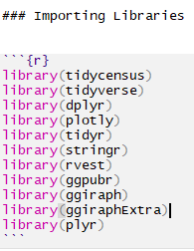
Goal of the Project:
To evaluate the impact of
per capita income on educational attainment.
Notes:
The goal is to evaluate the impact of per capita income on educational attainment.
And the libraries that I are used are as mentioned.
Here tidycensus library helped in making an API call to get Census data that is pre-prepared for exploration within the tidyverse.
I have used ggPredict() function using ggpubr library– to Visualize the Regression Model.
rvest library made the scraping of the data from web pages possible.
Dplyr library helped me solve the data manipulation challenges.

Slide 4
STEPS to achieve the Goal
Collect the required data.
Perform the exploratory data analysis (EDA).
Perform extract load and transform (ETL) process.
Design a relational database to import tables in PostgreSQL.
Apply a linear regression model.
Estimate the correlation between per capita income and the bachelor's degree attainment.
Interpretation of the results.
Notes:
Now steps to achieve the goal are that I first fetched the data from three data sources.
After performing the exploratory data analysis(EDA) and thoroughly cleaning the data during the extract load and transform(ETL) process, I designed a relational database.
Then I applied the Linear regression model to the merged dataset to find out the correlation between the variables.
And finally, I interpreted the results.

Slide 5
Data Sources:
Web Scraping is performed to fetch fips code for all US counties:
https://en.wikipedia.org/wiki/List_of_United_States_FIPS_codes_by_county
API call to fetch Census data for all US counties:
https://api.census.gov/data/2019/acs/acs1?get=NAME,B01001_001E&for=county:*
A CSV file is downloaded from 'Economic Research Service’ U.S. DEPARTMENT OF AGRICULTURE:
https://www.ers.usda.gov/data-products/county-level-data-sets/download-data/
Notes:
All my three data sets are at US county level. When performing the web scraping from Wikipedia page for the fips code data, the html source code is generated by calling the read_html function.
I used html_nodes function using CSS Selector and generated a table using html_table function.
Next, I access the Census API key, save it in the environmental variable and fetched the Census Data for the year 2020.
And lastly, after downloading the education data csv file from the 'Economic Research Service, USDA, I pushed it on Github, and imported the raw data into the Rmd file.

Slide 6
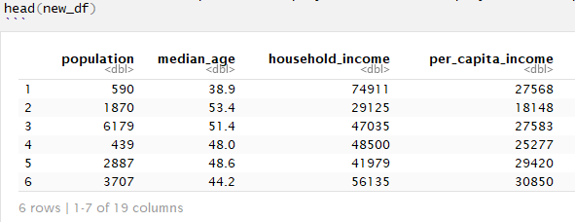
Data Cleaning Steps:
The three dataframes ready for cleaning are: fips_df, census_df, and education_df.
Removing strings like 'county’.
Convert column names to lowercase.
Dropping the null rows.
Renaming the columns.
Converting CHAR to NUM.
Split the name into two county and state columns.
Selecting the column of interest.
Exporting file as csv to working directory for creating a relational database using Quick DBD tool.
Finally, merging the three dataframes on fips code in new_df.
Notes:
Now my three data frames are ready to be cleaned.
For that I performed the following mentioned data cleaning steps.
Then exported the three CSV files to the working directory for designing the relational database.
And finally, after merging the three dataframes into new dataframe it is ready to apply linear regression model to investigate the impact of per capita income on education.

Slide 7
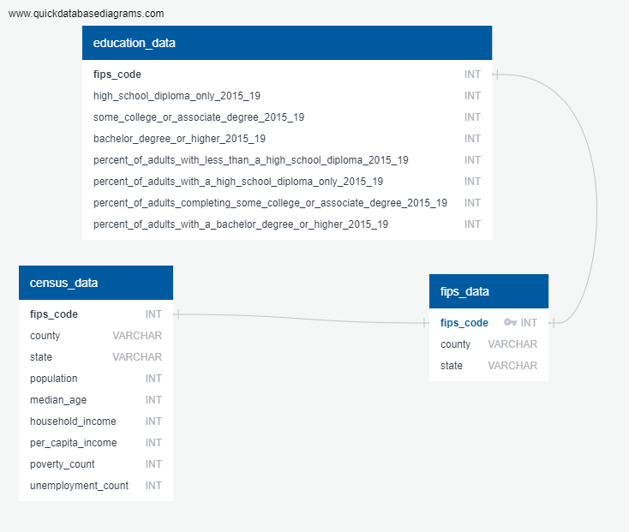

Relational database Design:
Notes:
Here is the relational database design that I performed using the Quick DBD tool.
And from here the CSVs are ready to be imported into PostgreSQL database.

Slide 8
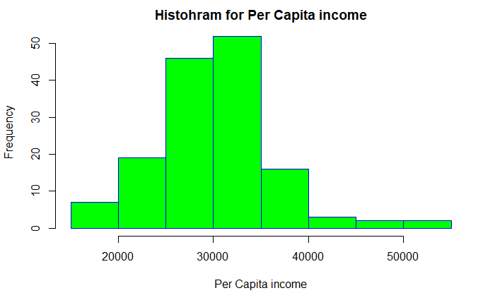
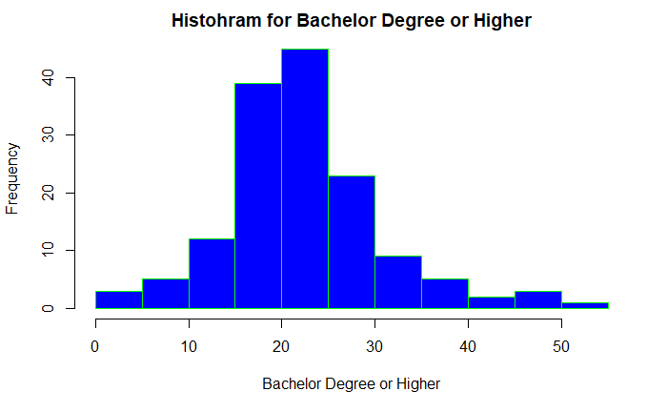
Assumptions for performing the linear regression:
Independence of observations (aka no autocorrelation).
Normality.
Linearity.
Homoscedasticity (aka homogeneity of variance)
Notes:
But before applying the linear regression model, the following four assumption must be made, and data must be visualized based on these assumption.
For the Independence of observations : Since I am interested only in one independent variable and one dependent variable, we don’t need to test for any hidden relationships among variables.
2. The normality can be checked by using the hist() function, which tells whether the dependent variable follows a normal distribution or not.
And the histograms here shows that our data follows a normal distribution.
For checking the Linearity among the variables, and homogeneity of variance we will go to the next slides.

Slide 9
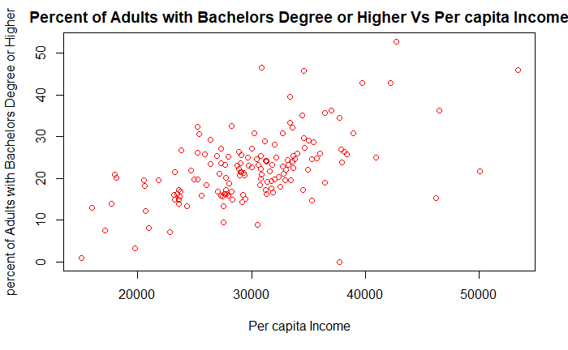
scatter plot for Assumption test
Notes:
3. According to the assumption the relationship between the percent of adults with a bachelors' degree and higher and per capita Income must be linear. We can check this visually with a scatter plot that the distribution of data points could be described with a straight line.

Slide 10
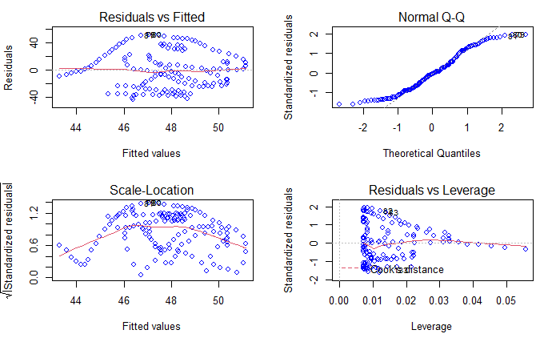
Homoscedasticity (aka homogeneity of variance)
Notes:
4. And a series of visualization are plotted to check the homogeneity of variance.
The red lines representing the mean of the residuals are all basically horizontal and centered around zero. This means there are no outliers or biases in the data that would make a linear regression invalid.
In the Normal Q-Qplot in the top right, we can see that the real residuals from our model form an almost perfectly one-to-one line with the theoretical residuals.
Based on these residuals, we can say that our model meets the assumption of homogeneity of variance.
and the appropriate visualizations helps us better understand the data.

Slide 11
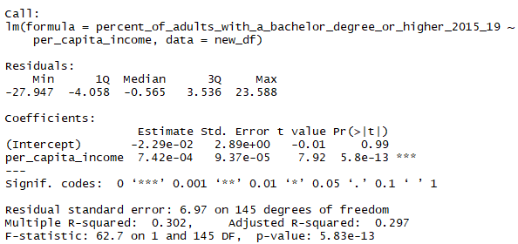
Simple Linear Regression Model & Summary:
Simple Linear Regression Equation:
percent_of_adults_with_a_bachelor_degree_or_higher_2015_19 =
b0 + b1*per_capita_income
The F-Test of overall significance has the following two hypotheses:
Null hypothesis (H0) : The model with no predictor variables (also known as an intercept-only model) fits the data as well as the regression model defined here.
Alternative hypothesis (HA) : Regression model fits the data better than the intercept-only model.
Notes:
Now the simple linear regression model is applied and following summary is obtained.
Here as mentioned earlier, the dependent variable is the ‘percent_of_adults_with_a_bachelors_degree_or_higher’ and the independent variable is per_capita_income
Interpretation of the summary:
A large F-statistic will correspond to a statistically significant p-value (p < 0.05). In our example, we can see that the F-statistic equal 62.7 producing a p-value of 5.83e-13, which is highly significant. This means that, the predictor variables is significantly related to the dependent variable.
Our Null hypothesis (H0) : The model with no predictor variables fits the data, as well, as the regression model.
Alternative hypothesis (HA) : Regression model fits the data better than the intercept-only model.
And I accept the alternate hypothesis that our regression model fits the data better than the intercept-only model.
For a given predictor, the t-statistic evaluates whether there is significant association between the predictor and the outcome variable, that is whether the beta coefficient of the predictor is significantly different from zero.
Thus, the change in per_capita_income variable is significantly associated to change in percent_of_adults_with_a_bachelor_degree_or_higher_2015_19
For a given predictor variable, the coefficient (b) can be interpreted as the average effect on y of a one unit increase in predictor, holding all other predictors fixed.
One unit increase in per_capita_income will significantly increase percent_of_adults_with_a_bachelor_degree_or_higher_2015_19, holding all other predictors fixed.

Slide 12
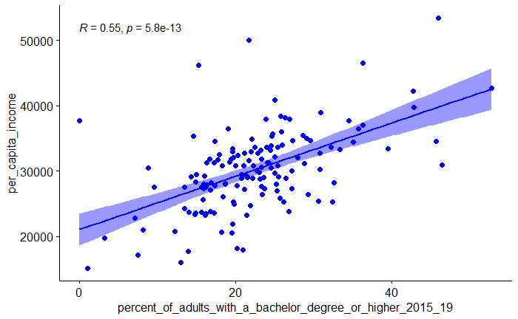
The correlation coefficient between the two variables
Notes:
The correlation coefficient between the two variables is , r=0.6 indicating a strong linear relationship between per capita income and percent of adult with a bachelor or higher degree .
r is always a number between -1 and 1. r > 0 indicates a positive association. r < 0 indicates a negative association. Values of r near 1 indicate a strong linear relationship.
In our case, r=0.6 indicates a strong linear relationship.

Slide 13
Challenges encountered in code and/or data:
Web scraping the SAT score was the biggest challenge.
https://www.nj.com/education/2019/05/see-the-sat-scores-for-every-nj-public-high-school.html
Merging three data frames was not easily achievable.
Notes:
Here are the challenges that I encountered.
Initially, to find the correlation between per capita income and educational attainment, I was considering to scrape the SAT scores of students.
But after trying all possibilities, it becomes clear that it is not a user-friendly scrapable site. So, I switch to 'Economic Research Service’ USDA site for fetching the education data..
Merging three data frames was not easily achievable until I figured out that the common column had hidden spaces which were creating a mismatch, so it was thoroughly cleaned.

